Slide 1
CRM
Hello, Goodbye
The New Spin on Customer Loyalty

Slide 2
Three Eras in the History of Marketing
Production Era
  “A good product will sell itself.”
Sales Era
  “Creative advertising and selling will overcome consumer resistance and convince them to buy.”
Marketing Era
  “The consumer is king! Find a need and fill it.”

Slide 3
Profitability of Long-Life Customers
According to a study conducted by the American Management Association (as cited in Vavra, 1992), 65 percent of the average company’s business comes from its present, satisfied customers
Costs a company 6x’s more to sell a product to a new customer than it does to an existing one

Slide 4
Profitability of Long-Life Customers
A business that each day for one year loses one customer who customarily spends $50/week would suffer a sales decline of $1,000,000 the next year
Reichheld (as cited in Swift, 2001) found that companies could boost profits by 100 percent by retaining just 5 percent more of their customers.

Slide 5
Relationship Marketing
Relationship marketing involves long-term, value-added relationships developed over time with customers and suppliers.
Relationship marketing recognizes the critical importance of internal marketing to the success of external marketing plans (Boone and Kurtz, 2001)

Slide 6
Relationship Marketing
Morgan and Hunt (1994) proposed the following definition of relationship marketing:
  Relationship marketing refers to all marketing activities directed toward establishing, developing, and maintaining successful relationship exchanges

Slide 7
Relationship Marketing
Morgan and Hunt (1994) theorized that successful relationship marketing requires relationship commitment and trust.
  The authors proposed that relationship commitment was central to relationship marketing and that trust was central to all relational exchanges.

Slide 8
Database Marketing
The development of database marketing has had a tremendous effect on the improvement of marketing strategy.
Utilized initially by catalogs, record clubs, and credit-card companies to manage customer information, databases are more widely accepted as a result of improved technology (“DB marketing, promise and reality, “1993)

Slide 9
Database Marketing
The growth in database marketing together with the switch from mass marketing to one-to-one marketing has changed the face of relationship marketing.

Slide 10
The Changing Role of Relationship Marketing
The role of technology has assisted in relationship marketing and has grown to represent a new form of competitive advantage.
Both marketing researchers and business practitioners have identified the implementation of technology as an essential component of relationship marketing

Slide 11
Customer Relationship Management Era
According to Stewart Deck (2001), customer relationship management (CRM) is a strategy used to learn more about customers’ needs and behaviors in order to develop stronger relationships with them.
It can be thought of as a process that will bring together lots of pieces of information about customers, sales, marketing effectiveness, responsiveness and market trends

Slide 12
Customer Relationship Management Era
Customer relationship management is an attempt to modify customer behavior over time and strengthen the bond between the customer and the company.
The key to CRM is identifying what creates value for the customer and then delivering it (Newell, 2000).

Slide 13
Defining CRM
Dr. Robert Shaw (as cited in Customer Relationship Management, 2001) provides a more thorough definition of CRM.
Customer relationship management is an interactive process for achieving the optimum balance between corporate investments and the satisfaction of customer needs to generate the maximum profit. CRM involves:

Slide 14
Defining CRM
Measuring both inputs across all functions including marketing, sales and service costs and outputs in terms of customer revenue, profit and value.
Acquiring and continuously updating knowledge and customer needs, motivation and behavior over the lifetime of the relationship.

Slide 15
Defining CRM
Applying customer knowledge to continuously improve performance through a process of learning from successes and failures.
Integrating the activities of marketing, sales and service to achieve a common goal.

Slide 16
Defining CRM
The implementation of appropriate systems to support customer knowledge acquisition, sharing and the measurement of CRM effectiveness.
Constantly flexing the balance between marketing, sales and service inputs against changing customer needs to maximize profits.

Slide 17
Relationship Marketing and Customer Relationship Management
The basic tenet of relationship marketing and customer relationship management is that firms benefit more from maintaining long-term customer relationships than short-term customer relationships (Reinartz & Kumar, 2000)
Business is becoming more customer-centric every day.
Customers demand highly personalized products, personalized services and immediate delivery.

Slide 18
Why CRM?
The surge of interest in CRM can be explained in part by the tremendous growth of the Internet and electronic commerce (e-commerce).
Internet growth and online retail revenue are projected to continue over the next decade.
According to Jupiter Media Metrix (Ploskina, 2001), U.S. online retail revenue was supposed to leap from $25 billion in 2000 to $118 billion in 2004.
Framingham, Mass.-based IDC predicts that e-commerce will grow from $130 billion in 1999 to $2.5 trillion in 2004 (Kalin, 2000).

Slide 19
Why CRM?
This growth in retail sales can be attributed to the remarkable increase of web users. Nielsen//NetRatings (2001) released the June 2001 Home Internet Access estimates for web usage for the US showing a record 167.1 million users

Slide 20
The Goal of CRM
According to Stewart Deck’s October 15, 2001 article in CIO Magazine, the primary goal of CRM is to help businesses use technology and human resources to gain insight into the behaviors of customers and the value of those customers.

Slide 21
The Goal of CRM
If this goal is met, a business can:
  Provide better customer service;
  Make call centers more efficient;
  Cross sell products more effectively;
  Help sales staff close deals faster;
  Simplify marketing and sales processes;
  Discover new customer and ultimately
  Increase customer revenues.

Slide 22
CRM Business Objectives
The following list represents a set of legitimate CRM business objectives from several of my clients currently in the throes of their CRM programs:
· “We want to thoroughly understand our customers' needs—even before they know them themselves.”—A mid-market financial institution
· “Decreasing customer churn by increasing customer satisfaction.”—A competitive local exchange carrier
· “Motivating customers to initiate revenue-generating contacts with us.”—An online insurance company
· “Increasing the likelihood of the 'right response' by a given customer or customer segment.”—A catalog retailer
· “To use technology to improve customer service and enable a greater degree of customer differentiation in order to deliver unique customer interactions.”—A data services firm
· “We want to attract customers—both old and new—through more personalized communications.”— An online retailer

Slide 23
What is CRM?
First and foremost it’s a business strategy
It’s a business philosophy
It’s not one, but many visions.

Slide 24
In a recent Information Week survey , of the companies actively implementing CRM, 93 percent claimed increased loyalty and customer satisfaction would justify their CRM investment. The second-highest percentage, 83 percent, stated the need to demonstrate increased revenue. The implied mandate for most of these early adopters seems to be “customer loyalty at any cost—even if we don't see a return on investment.”

Slide 25
How has internet changed the game?
Information availability
Information asymmetry
Zero latency / Decreased delivery times
· 24-hour access
· Up-to-the-minute information (on, for example, stock levels, product features, and prices)
· The ability to research a product or merchant during a shopping trip
· Online customer support
· Online self-service
· Personalized content

Slide 26
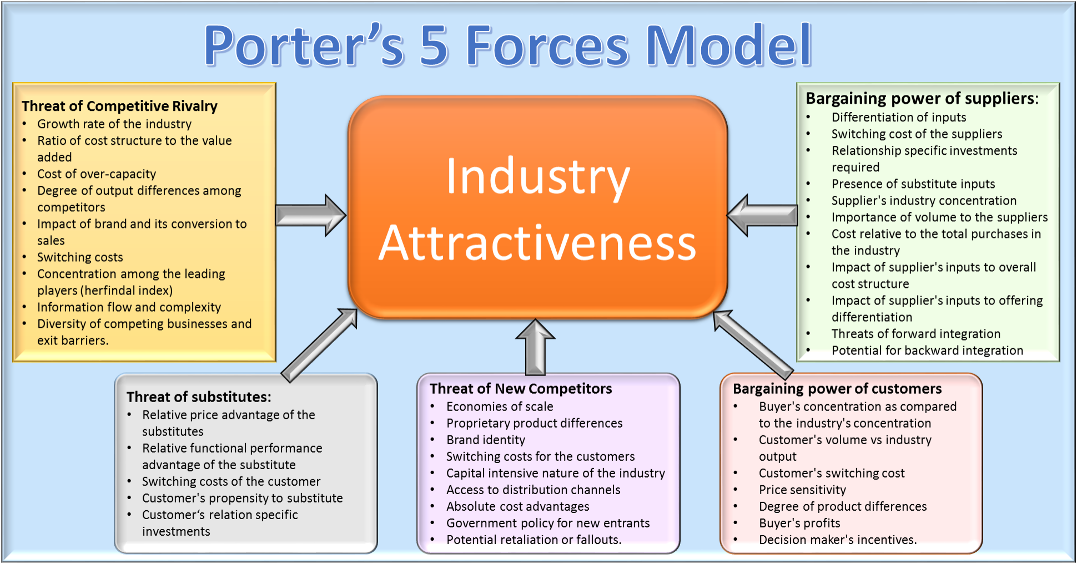
Porter’s Competitive Forces Model

Slide 27
Types of CRMs
· eCRM (alternatively, e-CRM). eCRM refers to “electronic” customer relationship management or, more simply, CRM that is Web-based. For instance, when you log on to golf retailer chipshot.com to see if they've shipped your new titanium driver, that's eCRM.
· ECRM. Somewhat confusingly, many experts and publications are using ECRM, alternatively coined “ERM,” to refer to “enterprise” CRM, meaning a CRM program that spans an enterprise-wide view of a customer. (We'll spell out enterprise CRM to avoid any confusion with electronic CRM.)
· PRM. “Partner relationship management” allows a company to manage its alliance partner and reseller relationships to provide customers with the optimal sales channel while streamlining the sales process. Determining incentives for various Web referral sites based on the profitability of the customers they send your way is one PRM tactic.

Slide 28
· cCRM. “Collaborative CRM” denotes situations in which customers can interact directly with the organization, usually through the Web. Dell, for instance, allows customers to choose their own workstation components, essentially designing their own PCs.
· SRM. “Supplier relationship management” resembles PRM in that it focuses on keeping external vendors happy, but SRM limits its focus to actual suppliers. Often operationally focused, SRM helps companies evaluate and categorize suppliers for given projects to optimize supplier qualification and selection, thereby streamlining the supply chain.
· mCRM: “Mobile CRM” suggests the provision of data to customers, suppliers, and business partners via wireless technologies.
· xCRM: You're bound to see other letters preceding the CRM acronym, and the “x” is simply used as a placeholder for other CRM hybrids to come.

Slide 29
CRM Implementation Strategies
Operational CRM, also known as “front-office” CRM, involves the areas where direct customer contact occurs. We'll refer to these interactions as customer “touchpoints.” A touchpoint can be an inbound contact —e.g., a call to a company's customer support hotline—or an outbound contact—e.g., an in-person sales call or an e-mail promotion. The majority of self-described CRM products on the market today fall into the operational category

Slide 30
Analytical CRM, also known as “back-office” or “strategic” CRM, involves understanding the customer activities that occurred in the front office. Analytical CRM requires technology (to compile and process the mountains of customer data to facilitate analysis) and new business processes (to refine customer-facing practices to increase loyalty and profitability). Under pressure from analysts and industry experts, most of today's CRM vendors are either creating analytical CRM capabilities or partnering with business intelligence (BI) vendors to incorporate analysis into their offerings.

Slide 31
Operational CRM
Touchpoints
  Media
  Physical
  Mail
  Phone
  Fax
  eMail
  Web Personal

Slide 32
CRM and Business Intelligence (Analytical CRM)
Data Warehouse
  Repository of corporate data
Data Mining
Business Intelligence
NONE OF THESE ARE AN EXAMPLE OF CRM

Slide 33
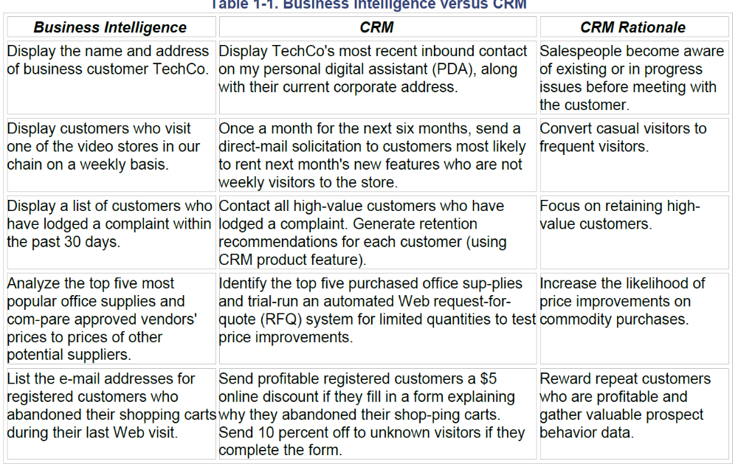

BI Vs CRM

Slide 34
Business Intelligence vs. CRM
Find an article of one company that has implemented a CRM project or is in the process of implementing one.
Write a one page summary to discuss in the next class meeting.

